Slide 1
INTRODUCTION TO KANBAN PROJECT MANAGEMENT
SAI RAVI TEJA PODDATURI -700738656
SAIKISHORE VOORA -700740310
VEERENDRA J -700744362
Priyanka Ramayanam – 700740910
Sai Roshan Poddaturi – 700744925
Dinesh Gummadidala – 700741247
GeetaSree Doddapaneni - 700744905

Slide 2
Project description
A kanban board is an agile project management tool designed to help visualize work, limit work-in-progress, and maximize efficiency (or flow). It can help both agile and DevOps teams establish order in their daily work.
Popular Kanban board applications include Trello, Jira, Kanbanize, Asana, and many others. Teams choose Kanban as a method for its flexibility, simplicity, and focus on continuous improvement. The digital tools enhance these benefits by providing real-time visibility, collaboration features, and analytics to help teams optimize their workflows.

Slide 3
Principles of kanban
Visualize the Work
Limit the Work in Progress (WIP)
Focus on Flow
Continuous Improvement

Slide 4
Advantages of kanban board
Visualizing workflow
Flexibility
Reduced lead time
Enhanced collaboration
Prioritization and focus
Customer satisfaction
Reduced waste
Ease of implementation

Slide 5
Steps to implement Kanban in a project
Understand your current process
Define Work item types
Visualize the workflow
Set WIP Limits
Add workitems
Implement pull system
Hold Regular standard up meeting
Continuously improve

Slide 6
Contin…
Measure and Analyze metrics
Adapt to changes
Provide training and Support
Integrate with other tools
Document and share best practices
Celebrate successes

Slide 7
Technologies we used
Front end : React js
Backend : spring boot
Database : h2

Slide 8
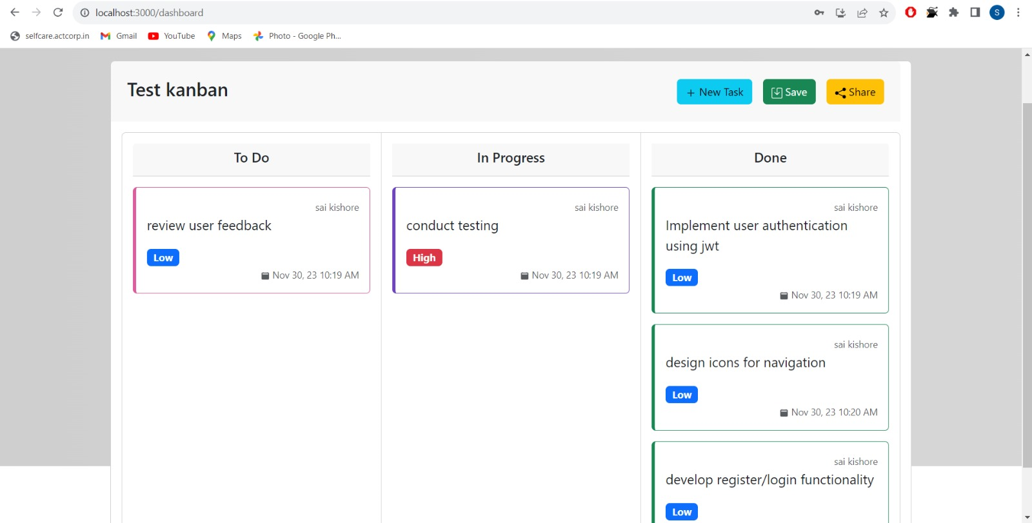
Example ..

Slide 9
Conclusion
Kanban is an effective and simple method to optimize task management. It not only increases transparency but also boosts motivation because team members gain flexibility and influence in the working process.

Slide 10
Thank you

